Slide 1
Docker, Containers, etc.

Slide 2
What are containers?
An abstraction layer over the operating system
Enable multiple apps to run on a single node
Enable apps to use the resources of the host OS in isolation
Wrap up apps in a complete file system that contains everything they needs to run: code, runtime, system tools, etc.
Enables apps to work the same way, regardless of the environment they are running on

Slide 3
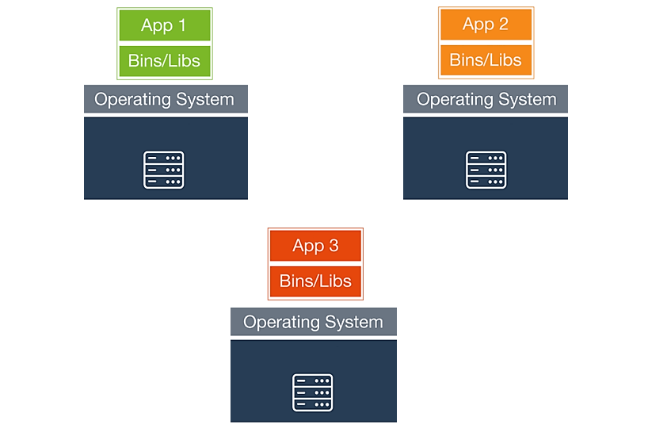
The past – Physical Servers

Slide 4
The past – Physical Servers
Apps deployed

Slide 5
The past – Physical Servers
Apps deployed to physical servers
Time to market subject to procurement lead times

Slide 6
The past – Physical Servers
Apps deployed to physical servers
Time to market subject to procurement lead times
Up-front capital expenditure

Slide 7
The past – Physical Servers
Apps deployed to physical servers
Time to market subject to procurement lead times
Up-front capital expenditure
On-going operational expenditure

Slide 8
The past – Physical Servers
Apps deployed to physical servers
Time to market subject to procurement lead times
Up-front capital expenditure
On-going operational expenditure
Largely inefficient resource utilisation

Slide 9
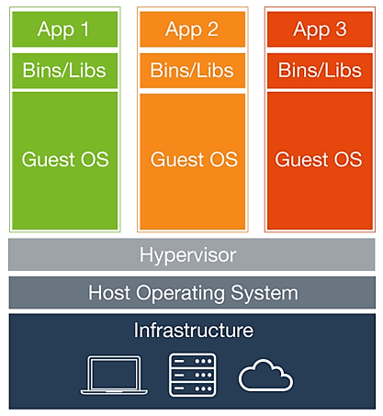
The present – Virtual Machines

Slide 10
The present – Virtual Machines
Virtual machines abstract over the physical hardware

Slide 11
The present – Virtual Machines
Virtual machines abstract over the physical hardware
Multiple apps running on the same infrastructure through VMs

Slide 12
The present – Virtual Machines
Virtual machines abstract over the physical hardware
Multiple apps running on the same infrastructure through VMs
Operating costs associated with each VM (CPU, RAM, disk)

Slide 13
The present – Virtual Machines
Virtual machines abstract over the physical hardware
Multiple apps running on the same infrastructure through VMs
Operating costs associated with each VM (CPU, RAM, disk)
Maintenance costs associated with each VM (patching, upgrading, security, etc.)

Slide 14
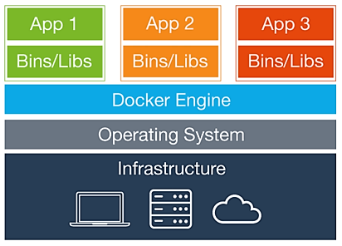
The future – Containers?

Slide 15
The future – Containers?
Maximise resource utilisation

Slide 16
The future – Containers?
Maximise resource utilisation
Consistent deployment and execution in across environments

Slide 17
The future – Containers?
Maximise resource utilisation
Consistent deployment and execution in across environments
Infrastructure agnostic

Slide 18
The future – Containers?
Maximise resource utilisation
Consistent deployment and execution in across environments
Infrastructure agnostic
Lightweight

Slide 19
Container Registry
Repository for container images
Define and upload your own container images
Docker Hub is the official Docker registry on the web
Third party registries available (Amazon, Google, Quay, etc)

Slide 20
Container Orchestration
Defining the application components
Provisioning container hosts
Defining distribution of containers across hosts
Deploying application components as a unit

Slide 21
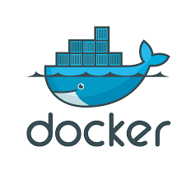
Docker

Slide 22
Docker
Docker is to containers what VMWare is to hypervisors
Docker Inc. is the major player in the container world
The Docker Project is open source
The Docker Project is made up of the docker engine and related tools
Public roadmap/release cycle
Backed by some of the biggest names in the industry
The Open Container Initiative

Slide 23
Docker - Cloud
Docker Hub
A hosted registry service
Registry capabilities for public and private content
Manage access and permissions through organisations/teams

Slide 24
Docker - Cloud
Docker Hub
A hosted registry service
Registry capabilities for public and private content
Manage access and permissions through organisations/teams
Docker Cloud
Deploy and manage dockerized apps with cloud tools
Integrate with cloud infrastructure services
Integrate with continuous delivery pipeline

Slide 25
Docker - Datacenter
Support for Docker Engine
Support from the source
Hot fixes, patches and support for older versions of Docker engine

Slide 26
Docker - Datacenter
Support for Docker Engine
Support from the source
Hot fixes, patches and support for older versions of Docker engine
Docker Trusted Registry
Private dedicated image registry
Store and manage images on-premises or on virtual private cloud

Slide 27
Docker - Datacenter
Support for Docker Engine
Support from the source
Hot fixes, patches and support for older versions of Docker engine
Docker Trusted Registry
Private dedicated image registry
Store and manage images on-premises or on virtual private cloud
Universal Control Pane
Deploy/manage dockerized apps
Deploy to private infrastructure or public cloud

Slide 28
Alternative Offerings
Kubernetes
Mesosphere DCOS
CoreOS
OpenStack Magnum
Quay.io
RancherOS
Etc.,

Slide 29
Docker Toolbox
Docker Engine - The docker engine
Docker Machine - Automated Docker provisioning
Docker Registry - Open source Docker image distribution
Docker Compose - Define multi-container apps
Docker Swarm - Host cluster and container scheduling
Kitematic - Desktop GUI for Docker

Slide 30
Docker Use Cases
Continuous Integration

Slide 31
Docker Use Cases
Continuous Integration
Continuous Delivery

Slide 32
Docker Use Cases
Continuous Integration
Continuous Delivery
DevOps

Slide 33
Docker Use Cases
Continuous Integration
Continuous Delivery
DevOps
Infrastructure Optimization

Slide 34
Showtime

Slide 35
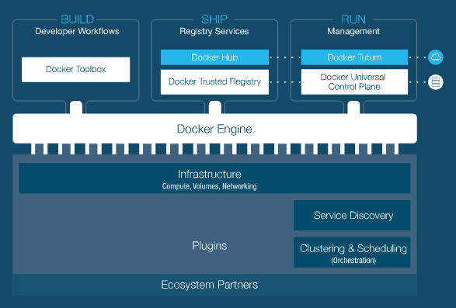
Summary

Slide 36
Summary
Containers are here
Docker is de facto standard
Ready made tools for the cloud and on-premises
Commercial support from Docker Inc. and others
Wider ecosystem
Big names: IBM, Microsoft, HPE, Dell, VMWare, AWS, Red Hat, etc.
Startups: Portworx, ClusterHQ, Rancher, Quay.io, Sysdig, CirclCI, etc.

